Slide 1

Project Phase 1: Review 1
PJ22CS22 - AI CRICKET SCORE
By
P RADHA RAI - 1VI19CS066
PRAKHAR KUMAR CHADRAKER - 1VI19CS070
SHAIK NOWSHEEN - 1VI19CS098
SHANTANU KUMAR SINGH - 1VI19CS100
Under the Guidance of
MS.VEENA G
ASSISTANT PROFESSOR

Slide 2
BIRD VIEW
2022 - 23
AI CRICKET SCORE
Introduction
Motivation
Abstract
Literature Survey
Comparative analysis of the survey
Problem Statement
Proposed System
System Specification
Expected outcome
Applications
References
1

Slide 3
INTRODUCTION
2022 - 23
AI CRICKET SCORE
Gesture Recognition pertains to recognizing meaningful expressions of motion by a human.
The applications of gesture recognition are manifold.
Ranging from sign language through medical rehabilitation, monitoring patients, sports gesture analysis,etc.
In Cricket, the Umpire has the authority to make important decisions about events on the field.
The Umpire signals important events using unique hand on signals and gestures.
The primary intention of our work is to design and develop a new robust method for Umpire.
2

Slide 4
MOTIVATION
2022 - 23
AI CRICKET SCORE
The human signal comprises of significant movement of hands, arms, face, head, or fingers.
This is a non-verbal method of correspondence and is appropriate for human-machine cooperation.
Sports authorities perform numerous signals which are demonstrative of what is happening in the game.
3

Slide 5
ABSTRACT
2022 - 23
AI CRICKET SCORE
Cricket is the 2nd most famous sports in Asia, 4th in Europe and also 2nd most famous sport in the whole world.
From 19th century the same old manual method is being used to update the scoreboard, which is a great burden for the scorekeeper.
The basic score updating process is still the same and performed by a person manually.
So in the 21st century an automatic system is very much needed at this sector.
Using modern equipment’s and machine learning algorithms we can increase the accuracy of the decision and provide flawless result that the naked eye misses.
This motivates us to design a system which will recognize gesture of cricket umpire in real time.
4

Slide 6
LITERATURE SURVEY - 1
2022 - 23
AI CRICKET SCORE
Title: Using Multiple Sensors for Mobile Sign Language Recognition [1]
Author: Helene Brashear, Thad Starner, Paul Lukowicz & Holger Junker
Methodology:
Sign Language recognition system with the goal of making it a mobile assistive technology.
The Experiment compares the results of training a small gesture vocabulary using noisy vision data, accelerometer data and both data sets combined.
Hidden Markov models are engineered to handle data which can be represented as 'sequence' of observations over time. There is marked improvement from vision (52.38% on Testing) and accelerometers (65.87% on Testing), and the combined set (90.48% on Testing)
Advantage: The user can monitor the camera’s view via the head mounted display. Provides accuracy.
Limitation: Data set is too small to trains using bigrams or trigrams and been trained on a very small vocabulary.
5

Slide 7
LITERATURE SURVEY - 2
2022 - 23
AI CRICKET SCORE
Title: A Color Hand Gesture Database for Evaluating and Improving Algorithms on Hand Gesture and Posture Recognition [2]
Author: Farhad Dadgostar, Andre L. C. Barczak, Abdolhossein Sarrafzadeh
Methodology:
Image database of hand posture and gesture images.
Details of the automatic segmentation and clipping of the hands are also discussed in this paper.
OpenCV,Povray Algorithm and Boundary Detection Algorithm is used.
Advantage: Automatically vary the lighting in all directions and even produce very complex patterns of lighting by introducing more than one source of light.
Limitation: Unless some special gadgets are used to control the lighting, it is very difficult to vary the positions of the light fairly along the three axis.
6

Slide 8
LITERATURE SURVEY - 3
2022 - 23
AI CRICKET SCORE
Title: Low cost approach for Real Time Sign Language Recognition [3]
Author: Matheesha Fernando, Janaka Wijayanayaka
Methodology:
Identify the signs and convert them into text and speech using appearance based approach with a low cost web camera.
A series of image processing techniques with Hub-moment classification was identified as the best approach.
Uses fast Convex Hull Algorithm for Binary image for pattern recognization,Histogram based classification.
Advantage: Helps in identifying a low cost, affordable method that can facilitate hearing and speech impaired people to communicate with the world in more comfortable way where they can easily get what they need from the society and also can contribute to the well-being of the society.
Limitation: This project only looks at the hand postures not on hand gestures.
7

Slide 9
LITERATURE SURVEY - 4
2022 - 23
AI CRICKET SCORE
Title: RGB-H-CbCr Skin Color Model for Human Face Detection [4]
Author: Nusirwan Anwar bin Abdul Rahman, Kit Chong Wei and John See
Methodology:
This paper presents a novel skin color model, RGB-H-CbCr for the detection of human faces.
Skin regions are extracted using a set of founding rules based on the skin color distribution obtained from a training set.
The proposed scheme was also compared with the well-known AdaBoost face detector/classifier by Viola and Jones.
The proposed scheme is able to reach comparable standards to that achieve by the AdaBoost algorithm (90.17%) on the similar data set.
Advantage: Brightness and illumination conditions can be effictively dealt.
Limitation: Low success of a robust face detector.
8

Slide 10
LITERATURE SURVEY - 5
2022 - 23
AI CRICKET SCORE
Title: A New 2D Static Hand Gesture Color Image Dataset for ASL Gestures [5]
Author: A.L.C. Barczak, N.H. Reyes, M. Abastillas, A. Piccio and T. Susnjak
Methodology:
It usually takes a fusion of image processing and machine learning algorithms in order to build a fully-functioning computer vision system for hand gesture recognition.
Machine learning need to feed on thousands of exemplars (e.g. images, features) to automatically establish some recognizable patterns for all possible classes (e.g. and gestures).
Image Segmentation & Recognition Algorithm have been used in this Paper.
Advantage:For gestures, no need to use special gloves, or any other apparatus.
Limitation:Images were taken at a certain angle of rotation (perpendicular to the subject), which limits the number of samples.
9

Slide 11
LITERATURE SURVEY - 6
2022 - 23
AI CRICKET SCORE
Title: Vision-Based Sign Language Translation Device [6]
Author: Yellapu Madhuri, Anitha.G, Anburajan.M
Methodology:
This report presents a mobile Vision-Based Sign Language Translation Device for automatic translation of Indian sign language into speech in English to assist the hearing and/or speech impaired people to communicate with hearing people.
This system is broken down into three main parts
a) Image acquisition
b) Image processing to extract features for recognition
c) Recognition stage where signs are identified and audio output is given.
Sign language is recognized using Lab View Software.
Advantage: Translator between deaf and people who do not understand sign language.
Limitation: Doesn’t focus on facial expressions.
10

Slide 12
COMPARATIVE ANALYSIS
2022 - 23
AI CRICKET SCORE
Reference | Algorithm/ Technique | Platform used | Performance Metrics | Advantage | Drawback
[1] | Accelerometers , Camera on top of head, Hidden Markov models | Windows | Mean, StdDev | Better view & accuracy. | Data set too small to train.
[2] | Open CV | Linux | Hand posture and gesture | Vary the lighting produce complex patterns. | Gadgets needed to control the lighting,
[3] | Histogram based classification | Linux | Hand outline, Hand contour, SIFT, SURF | facilitate hearing and speech. | Only looks at the hand postures not hand gestures.
11

Slide 13
COMPARATIVE ANALYSIS
2022 - 23
AI CRICKET SCORE
Reference | Algorithm/ Technique | Platform used | Performance Metrics | Advantage | Drawback
[4] | RGB-H-CbCr skin colour model, AdaBoost Algorithm | Windows | FDR, DSR | Brightness & illumination can be effictively dealt. | Low success of a robust face detector.
[5] | Image Segmentation,Recognition Algorithm | Linux | False Positive | No need to use special gloves | Certain angle of rotation needed.
[6] | Recognition of ASL using Lab View Software. | Windows,Linux,IOS,Android. | Geometric Features of Hand | Translator between deaf and people who don’t understand sign language. | Doesn’t focus on facial expressions.
12

Slide 14
PROBLEM STATEMENT
2022 - 23
AI CRICKET SCORE
In the stadium in front of thousands of crowd and due to heavy noise score board updater may miss some of the umpire signals.
Human eye the score updater may miss the umpire signal.
13

Slide 15
PROPOSED SYSTEM
2022 - 23
AI CRICKET SCORE
In this project, an umpire action and non-action detection and classification is developed based on Histogram of Oriented Gradients (HOG), Non-Linear SVM classifier and CNN.
The general methodology of the proposed technique includes division, highlight extraction, and umpire activity and non-activity outlines arrangement.
At first, the Umpire video frames are extracted from the Umpire Frames Segmented database and the 80% of Umpire Action and Non-action frames are selected manually and feature extraction is performed based on HOG and trained to CNN.
After that, the remaining 20% of the frames, feature extraction is performed using HOG and tested using trained CNN model, which categories the Action and Non-action Umpire Frames.
14

Slide 16
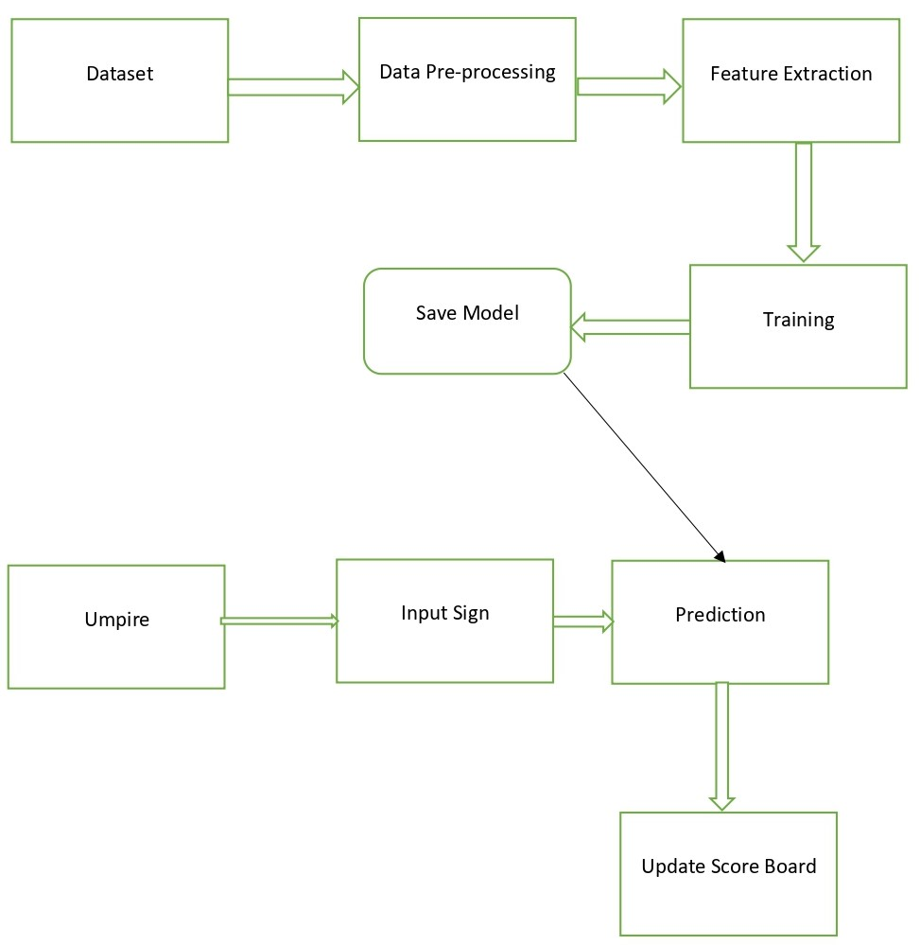
PROPOSED SYSTEM
2022 - 23
AI CRICKET SCORE
15

Slide 17
SYSTEM SPECIFICATION
2022 - 23
AI CRICKET SCORE
Hardware Requirement:
Processor : Intel i5
Speed : 2.4 GHz
RAM : 8 GB(minimum)
Hard Disk : 160 GB
Software Requirement:
Windows OS : Windows 10
Language : Python
Tools : Jupyter Notebook
16

Slide 18
EXPECTED OUTCOME
2022 - 23
AI CRICKET SCORE
To train the model using the collected umpire signals
To predict the umpire signal and update the score board
17

Slide 19
REFERENCES
2022 - 23
AI CRICKET SCORE
[1] H. Brashear, T. Starner, P. Lukowicz and H. Junker, "Using multiple sensors for mobile sign language recognition," Seventh IEEE International Symposium on Wearable Computers, 2003. Proceedings., 2003, pp. 45-52, doi: 10.1109/ISWC.2003.1241392.
[2] Dadgostar, Farhad & Barczak, Andre & Sarrafzadeh, Abdolhossein. (2005). A Color Hand Gesture Database for Evaluating and Improving Algorithms on Hand Gesture and Posture Recognition. Res. Lett. Inf. Math. Sci. 7. 127-134.
[3] M. Fernando and J. Wijayanayaka, "Low cost approach for real time sign language recognition," 2013 IEEE 8th International Conference on Industrial and Information Systems, 2013, pp. 637-642, doi: 10.1109/ICIInfS.2013.6732059.
18

Slide 20
REFERENCES
2022 - 23
AI CRICKET SCORE
[4] Nusirwan Anwar bin Abdul Rahman, Kit Chong Wei and John See Faculty of Information Technology, Multimedia University
[5] Barczak, A.L.C., Reyes, N.H., Abastillas, M., Piccio, A., Susnjak, T. (2011), A new 2D static hand gesture colour image dataset for ASL gestures, Research Letters in the Information and Mathematical Sciences, 15, 12-20
[6] Y. Madhuri, G. Anitha. and M. Anburajan., "Vision-based sign language translation device," 2013 International Conference on Information Communication and Embedded Systems (ICICES), 2013, pp. 565-568, doi: 10.1109/ICICES.2013.6508395.
19

Slide 21
APPLICATIONS
2022 - 23
AI CRICKET SCORE
Sport’s score board updates
Sign language
Traffic light control
20

Slide 22
THANK YOU
AI CRICKET SCORE
2022 - 23
21

